Slide 1


EDUBRIDGE DIGITAL ACADEMY (sponsored by Capgemini )
presentation
on
“EduGrocery (Grocery management)”

Slide 2
OVERVIEW
ABOUT THE DOMAIN
INTRODUCTION TO PROJECT
Abstract
Objective
Problem Statement
ARCHITECTURE
IMPLEMENTATION
Front-End
Back-End
RESULTS
APPLICATION

Slide 3
ABOUT THE DOMAIN
We have learned below topics :
AngularJS: Utilized for developing dynamic and responsive user interfaces on the frontend.
MySQL: Acts as the relational database management system (RDBMS) for efficient data storage and management.
Hibernate: Java-based ORM (Object-Relational Mapping) framework facilitating seamless interaction between the Java application and MySQL database for simplified data persistence operations.
JDBC (Java Database Connectivity):Provides a standard Java API for database access, enabling developers to execute SQL queries and manipulate database records programmatically.
Java: Primary programming language used for both frontend (with AngularJS) and backend development.
Spring Boot: A powerful framework simplifying the configuration and development of Java-based web applications. It provides features such as dependency injection, MVC architecture, and RESTful web services, enhancing productivity and efficiency in application development.

Slide 4
INTRODUCTION TO PROJECT
Abstract:
Edu grocery is a dynamic web application designed to revolutionize the online grocery shopping experience. Developed using a sophisticated technology stack comprising HTML, CSS, Angular, Spring Boot, and MySQL, this application offers users a seamless, intuitive, and feature-rich platform for purchasing groceries from the comfort of their homes.
The frontend, built with HTML and CSS, ensures a visually appealing and responsive user interface. Angular, a powerful front-end framework, enhances the interactivity of the application, providing users with a smooth and engaging shopping experience. The backend is supported by Spring Boot, which facilitates efficient server-side processing, ensuring quick responses to user requests.
The incorporation of MySQL as the relational database management system enables secure and scalable data storage. It efficiently manages essential aspects of the application, such as user profiles and transaction records.
Edu grocery focuses on user convenience by providing features such as easy navigation, a user-friendly shopping cart system, personalized recommendations, and secure payment options. The application optimizes the grocery shopping process, allowing users to browse a diverse range of products, add items to their cart, and complete transactions effortlessly.
Edu grocery represents a novel approach to the online grocery shopping landscape, utilizing modern technologies to create a user-centric platform that combines functionality, interactivity, and educational value. The synergy of HTML, CSS, Angular, Spring Boot, and MySQL ensures a robust and scalable solution for users seeking a comprehensive and enjoyable online grocery shopping experience.

Slide 5
Objective:
Efficient Inventory Management: Develop a system capable of tracking stock levels, managing suppliers, and monitoring product availability to optimize inventory management processes.
Streamlined Order Processing: Implement features allowing customers to browse products, place orders, and securely make payments, ensuring smooth and efficient order processing.
Enhanced Customer Engagement: Incorporate customer relationship management (CRM) functionalities such as personalized recommendations, order history tracking, and feedback mechanisms to improve customer engagement and satisfaction.
Problem Statement:
Traditional grocery retail methods suffer from inefficiencies in inventory management, order processing, and customer engagement. This project aims to develop a modern Grocery Management System (GMS) using MySQL, Spring Boot, and Angular to automate processes and enhance customer experiences, addressing these shortcomings effectively.

Slide 6
ARCHITECTURE
Front-End
Database layer
MySql
Client UI
Register
Login
Back-End
SpringBoot
Hibernate

Slide 7
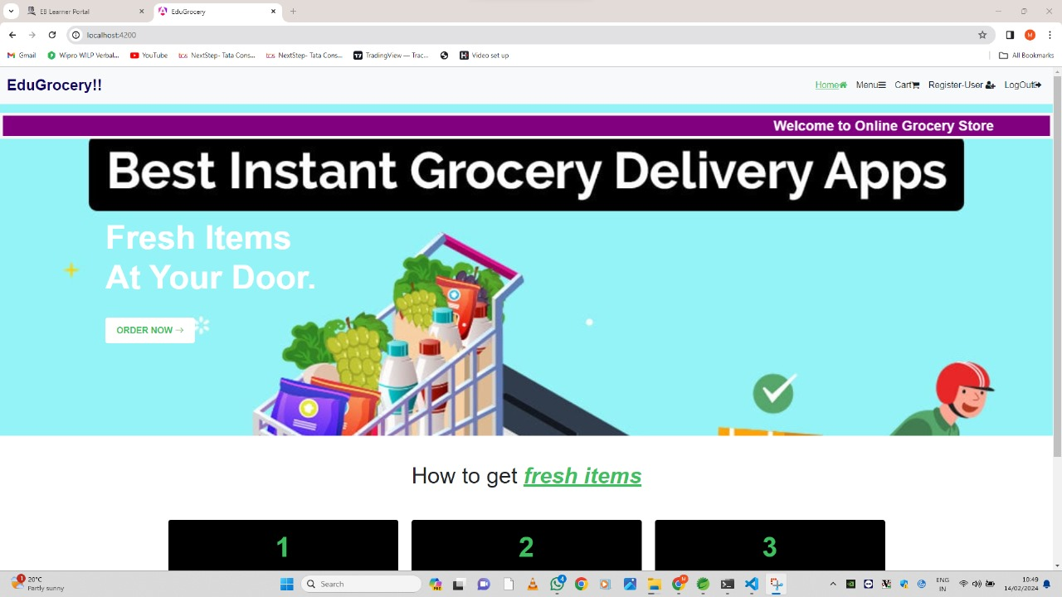
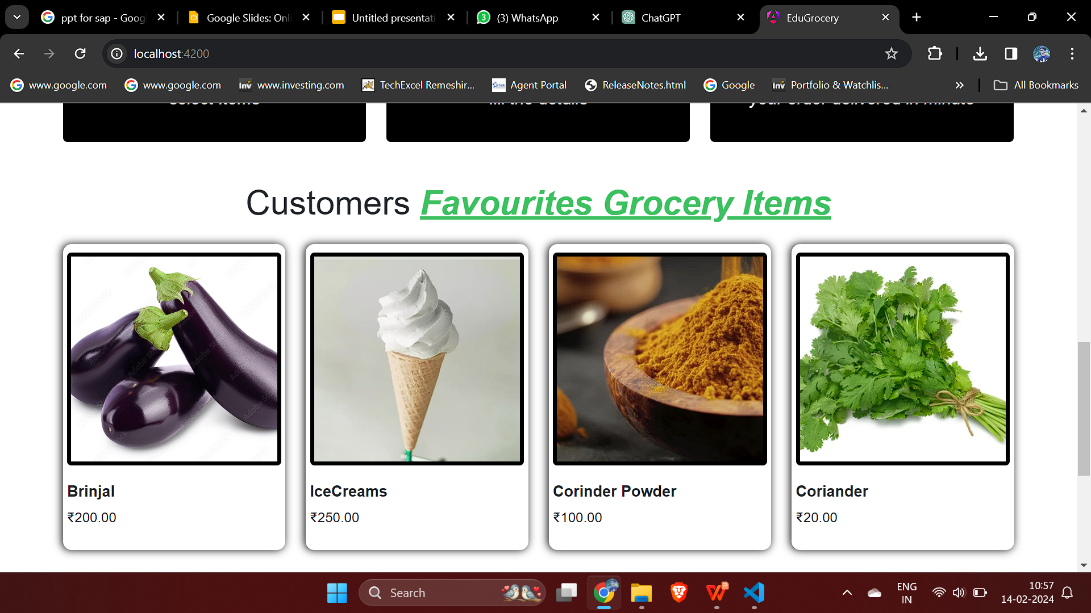
IMPLEMENTATION
Front- End:
We have use Angular as frontend and in our project we have five section that is:
Home-page- This section will navigate us to all the other section and help client to choose the product.

Slide 8
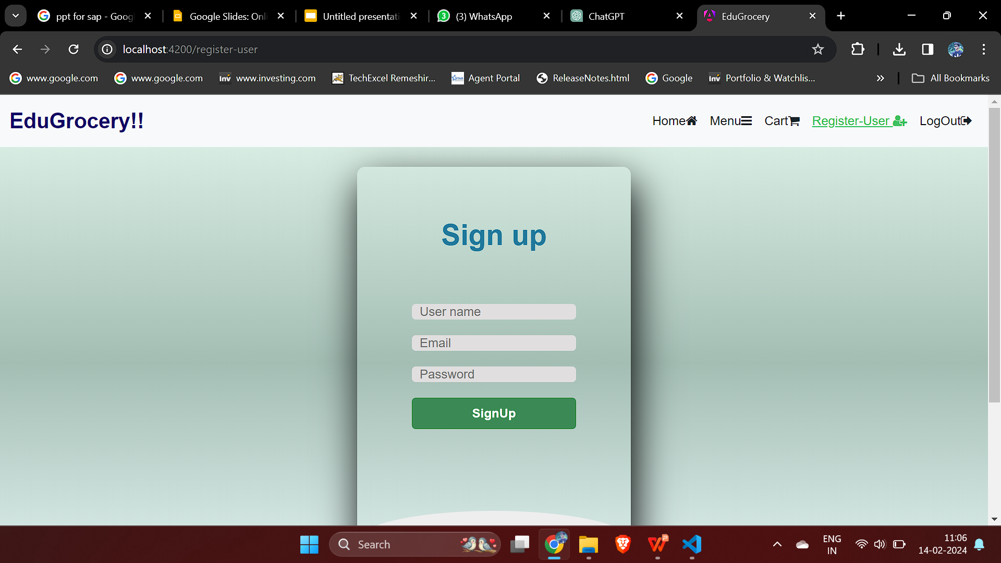
2.Register user : This page is used for registering the new user in the EduGrocery.

Slide 9
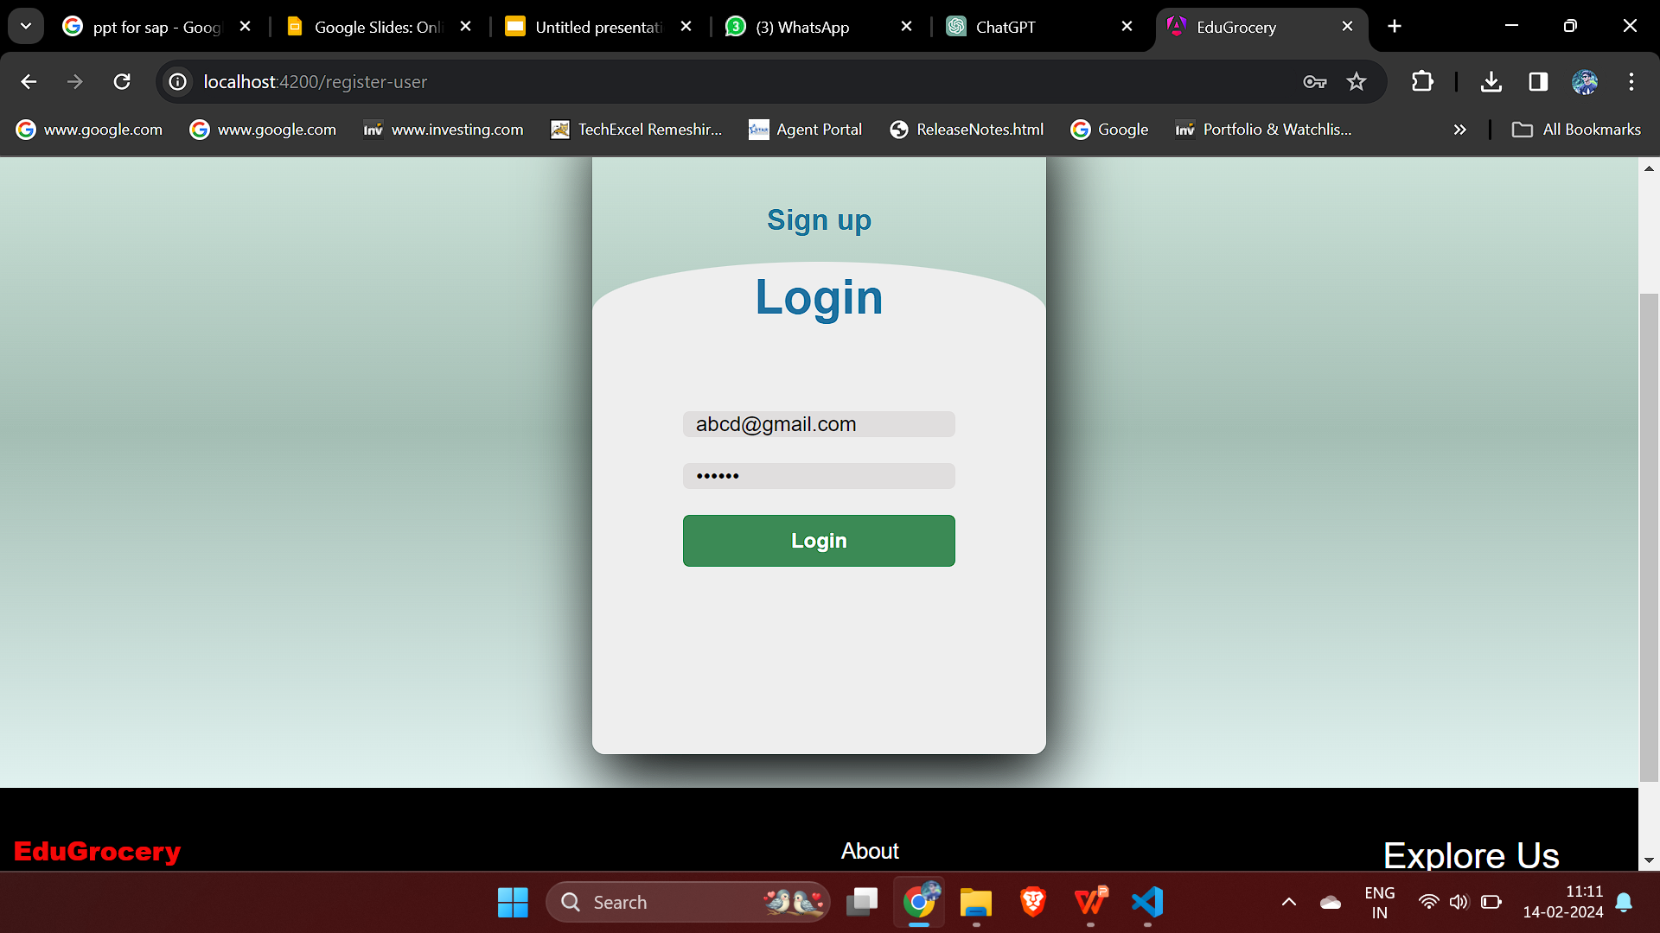
3.Login Page : Here the user can login with their email and password.

Slide 10
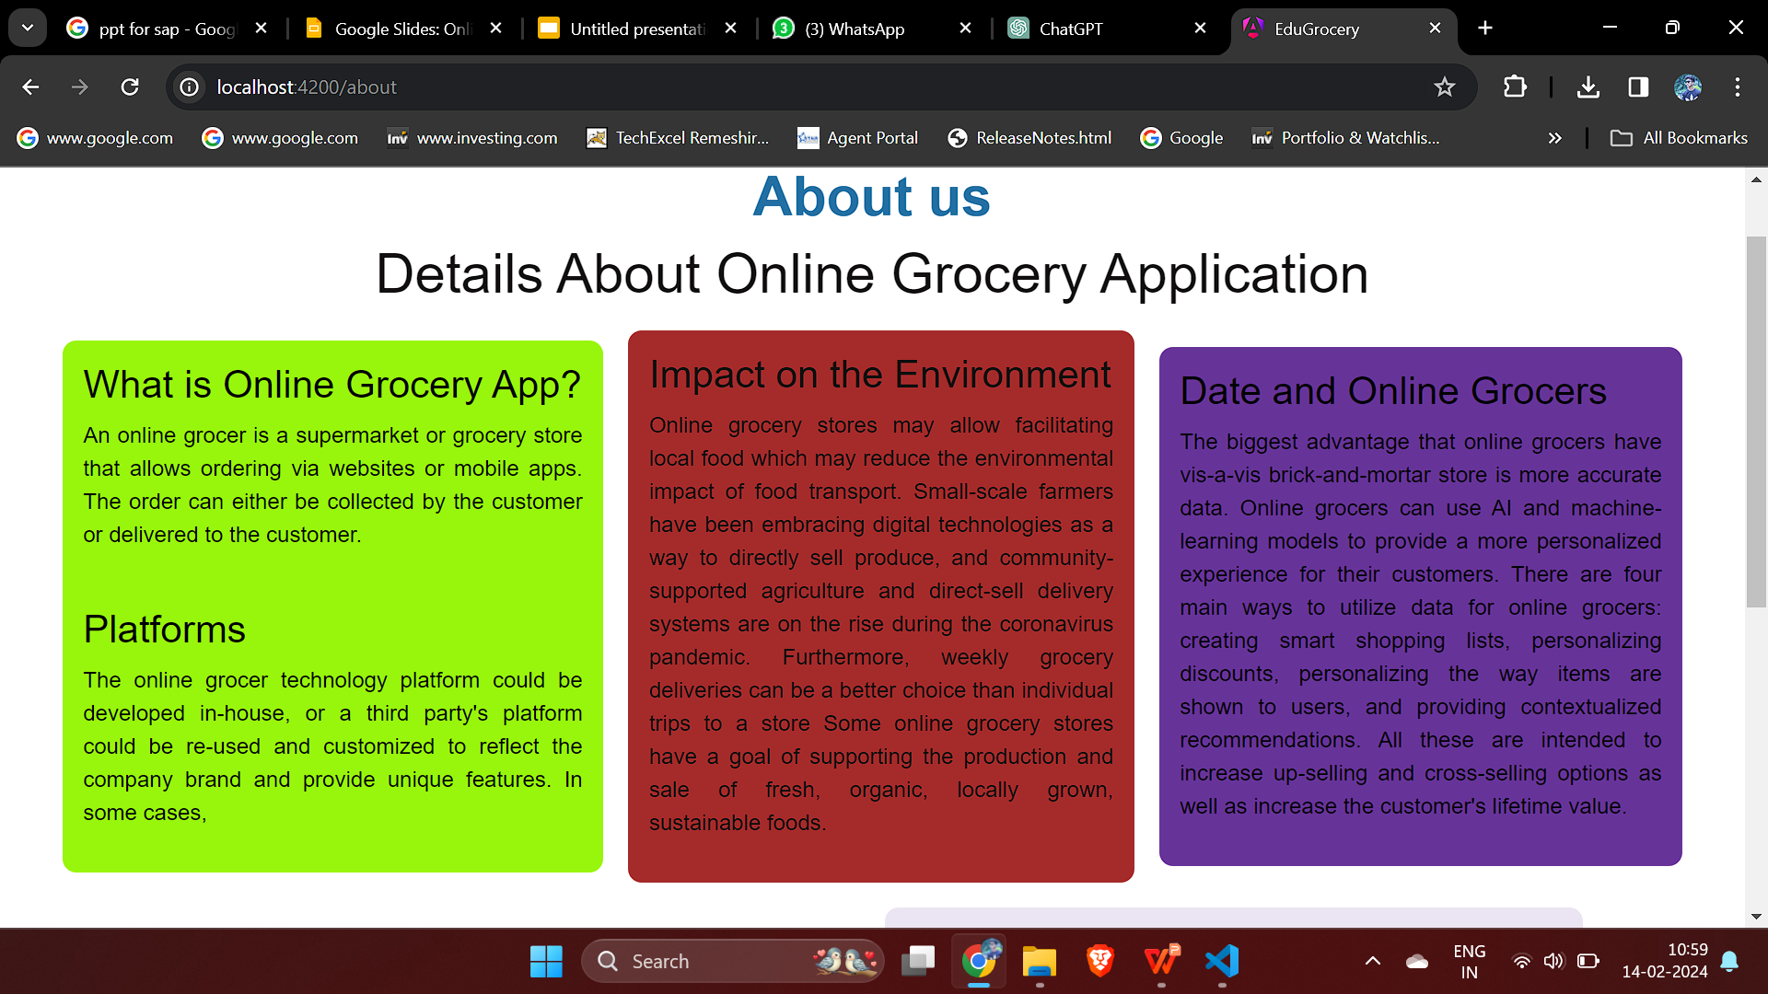
4.About-Us: This page will show about the EduGrocery what our vision.

Slide 11

5. Menu Page : Here we can see the products which can be added to the cart to buy the product.

Slide 12
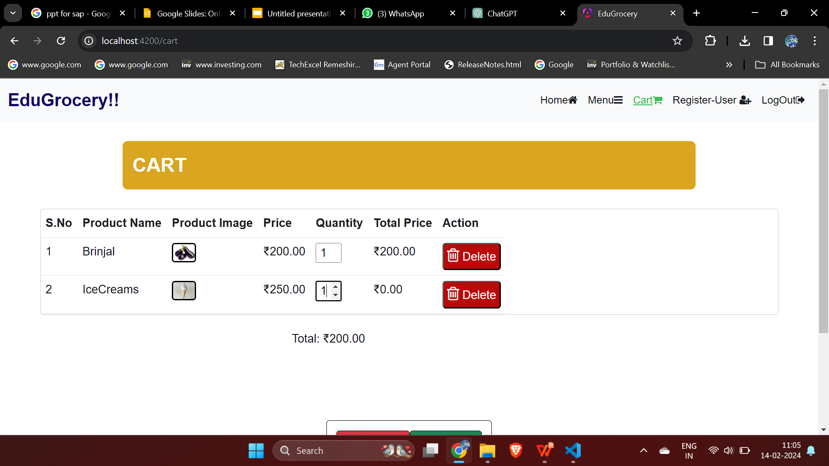
6.Cart Page : Here the User can look out for the added items in the cart with price .

Slide 13
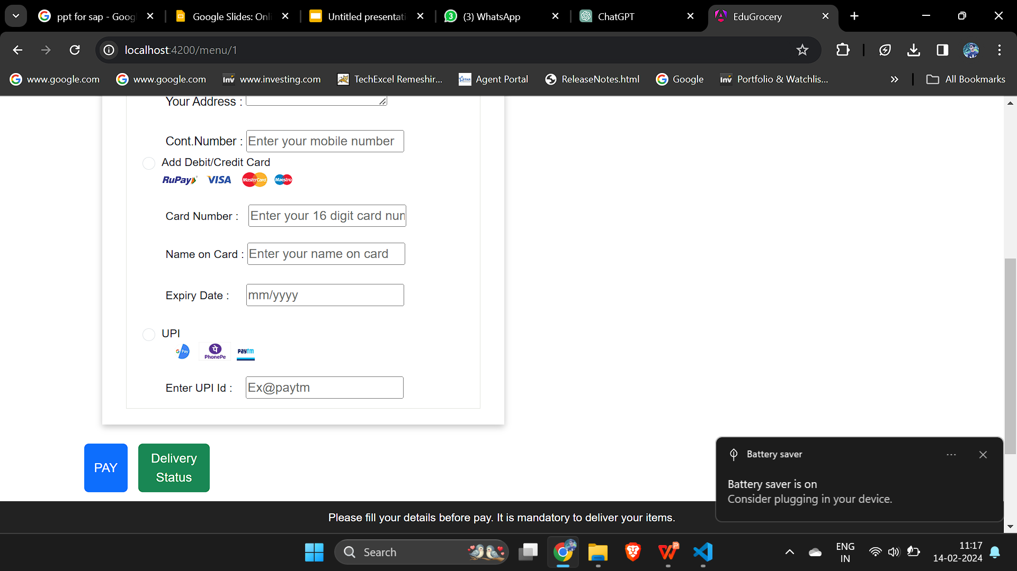
7.Payment Details

Slide 14
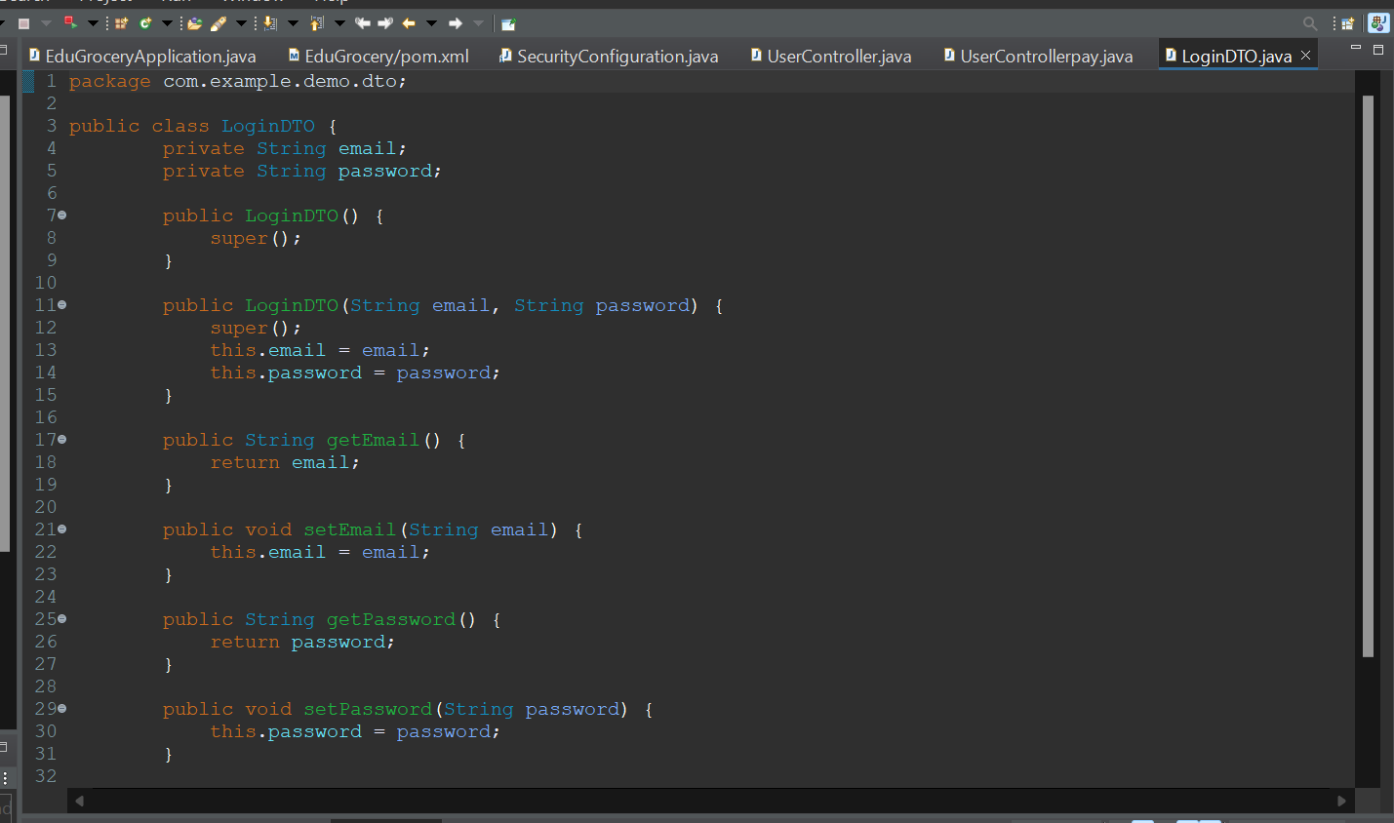
Back-end :
In back-end we have used Spring Boot and Hibernate. In this section we will user-Entity, Repository, Service, Controller to connect the front-end to back-end.
CODE snippet:

Slide 15
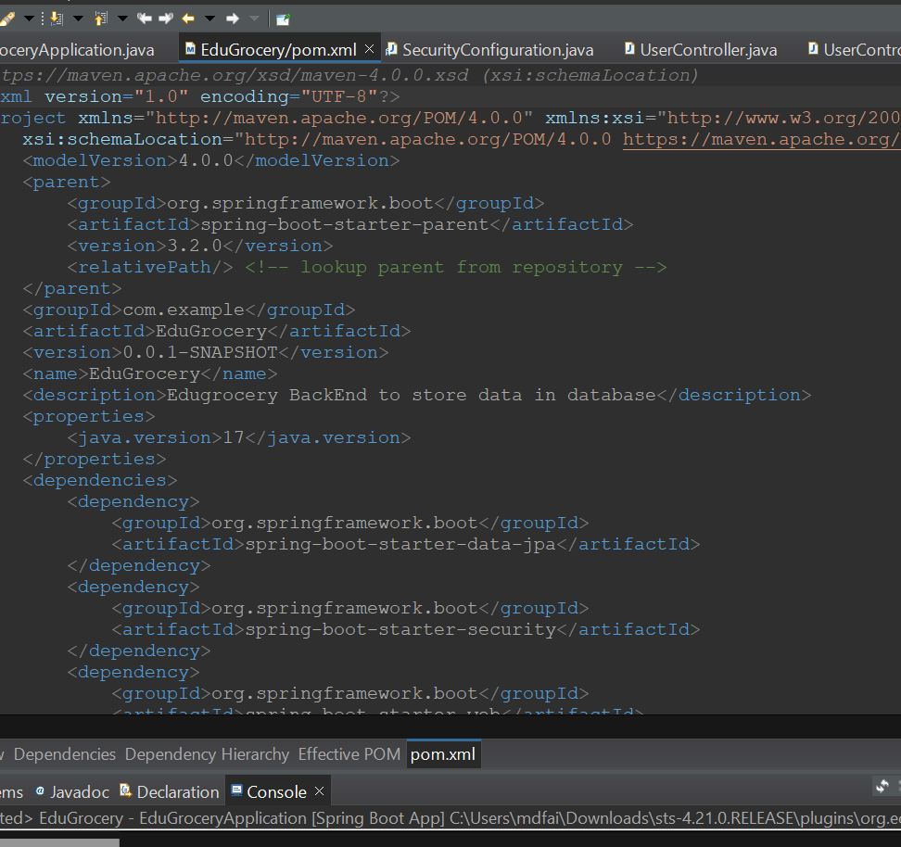
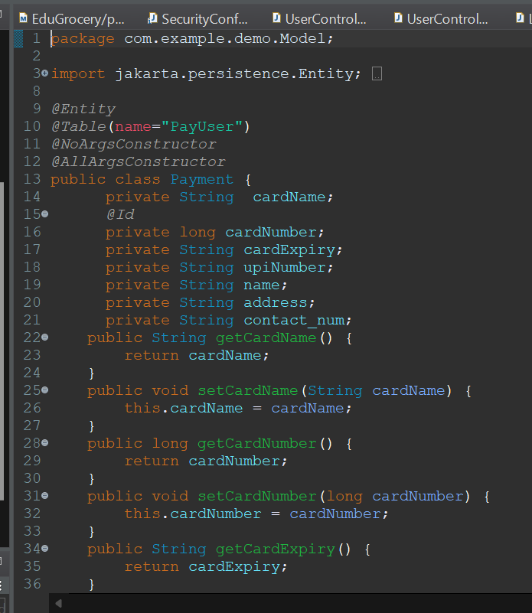
Category Code:

Slide 16
RESULT
Our EduGrocery is a game-changer, streamlining operations and delighting customers in the grocery retail sector. It simplifies inventory management, order processing, and customer engagement, making the shopping experience smoother. With a user-friendly interface and robust backend support, our system boosts productivity and ensures secure transactions. Its scalability means it can grow with your business, adapting to changing needs. Overall, the EduGrocery empowers grocery store owners to thrive in the digital age, offering efficiency and satisfaction in equal measure.

Slide 17
APPLICATIONS
User-friendly Interface: Intuitive interface developed with AngularJS for seamless browsing, ordering, and payment processing.
Inventory Management: Efficiently track stock levels, manage product categories, and receive automated alerts for low inventory.
Order Processing: Customers can easily place orders, with secure payment processing and order confirmation notifications.
Customer Engagement: Features include personalized product recommendations, order tracking, and feedback mechanisms to enhance customer satisfaction.
Backend Infrastructure: Developed using Java with Spring Boot, ensuring robustness and scalability, with Hibernate for efficient data persistence.
Security: Implementation of encryption, user authentication, and authorization for data protection and secure transactions.
Scalability and Performance: Architecture designed for scalability, providing a responsive user experience even during peak usage periods.

Slide 18
THANK YOU

